Slide 1

Short Linear Motifs in Pathogens
Hugo Samano-Sanchez
Toby Gibson’s group
Predoc course 2019
November 11th / 13th

Slide 2
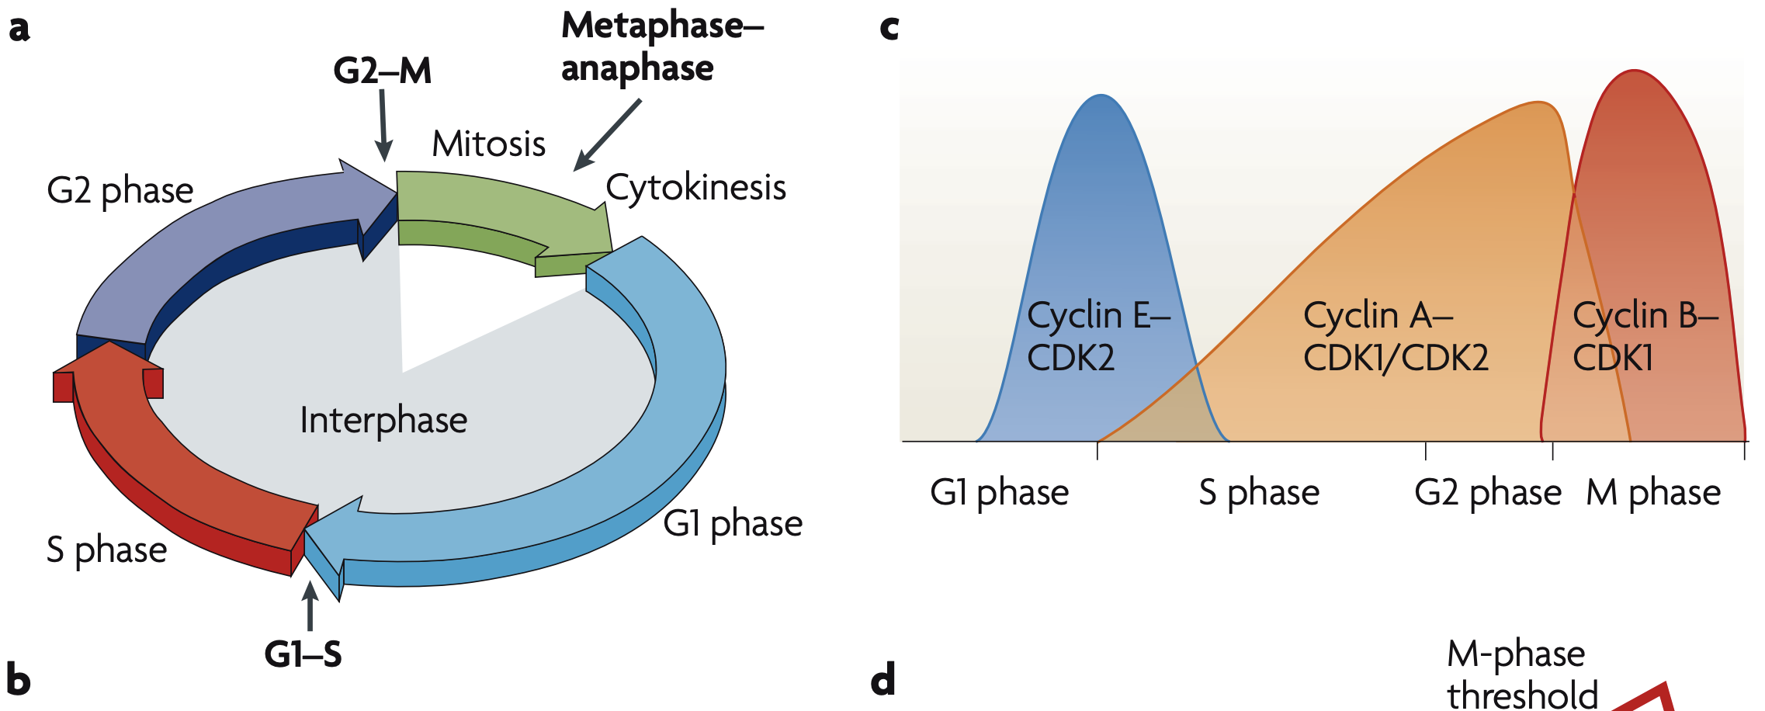

Cell Cycle: A Highly Regulated Process
Hochegger, H., et al., 2008

Slide 3
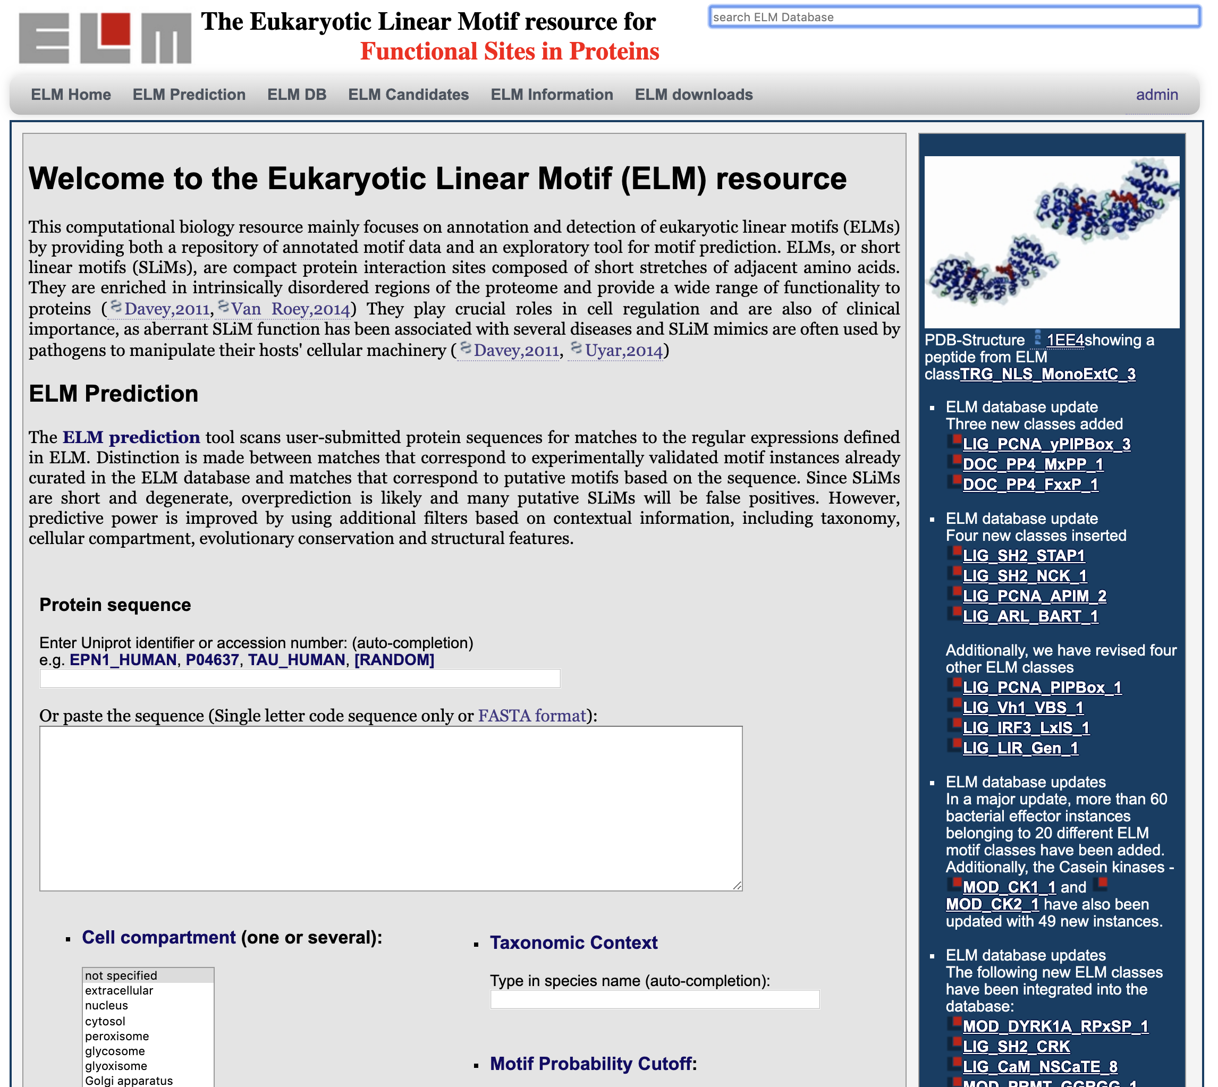
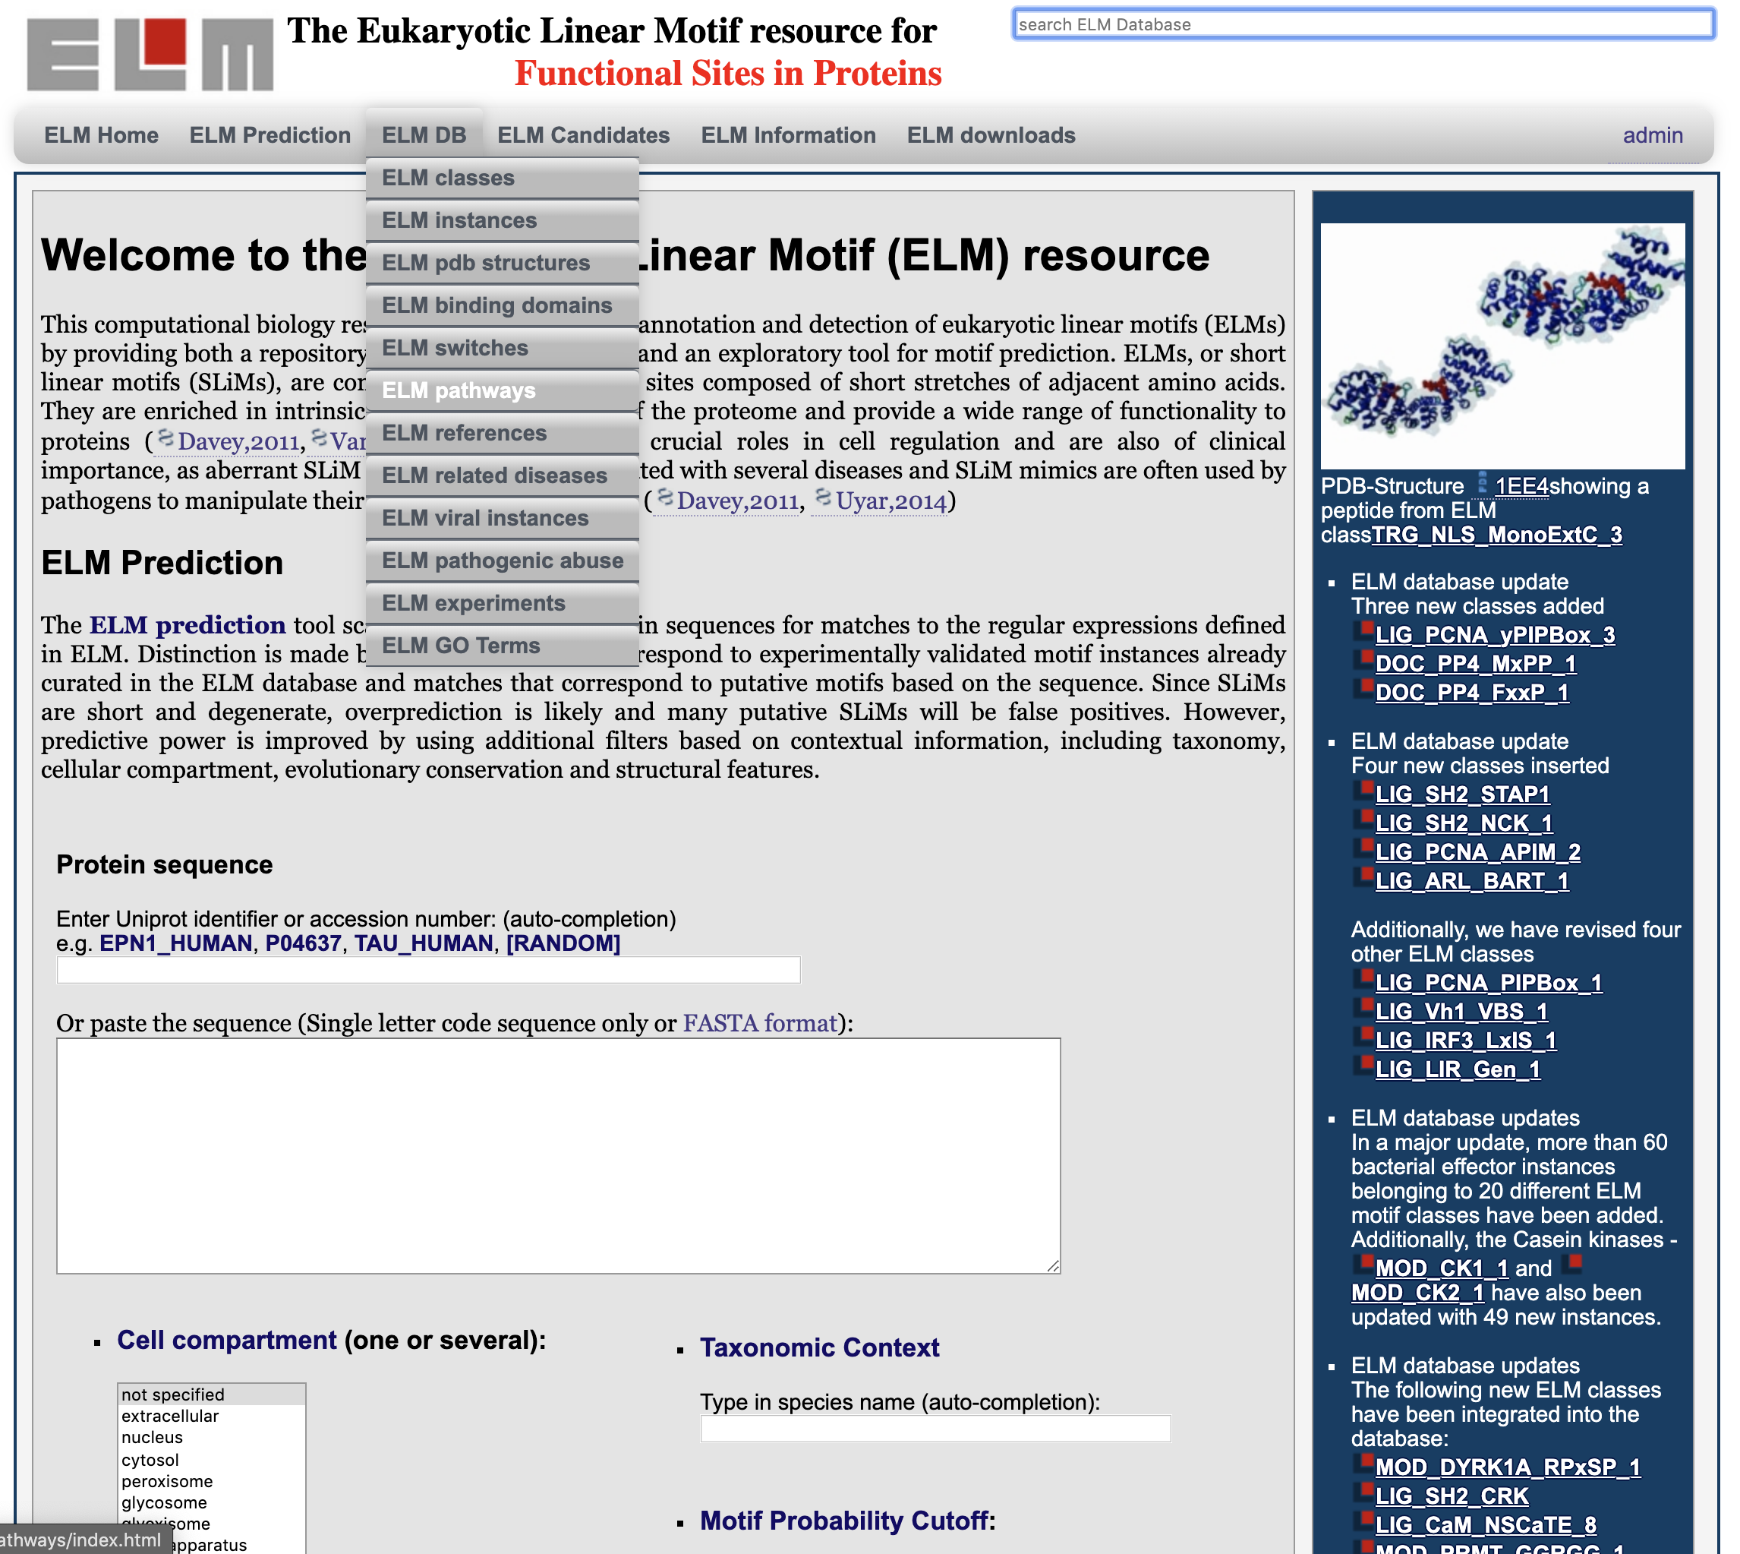
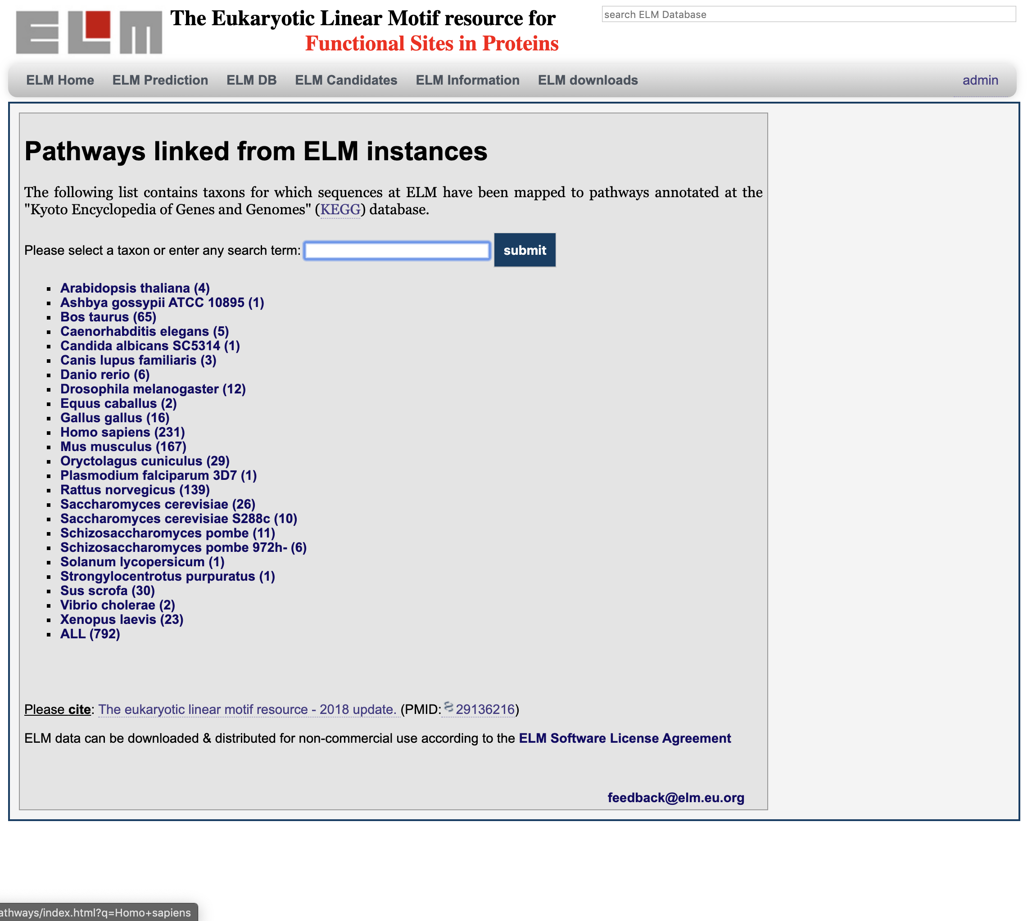
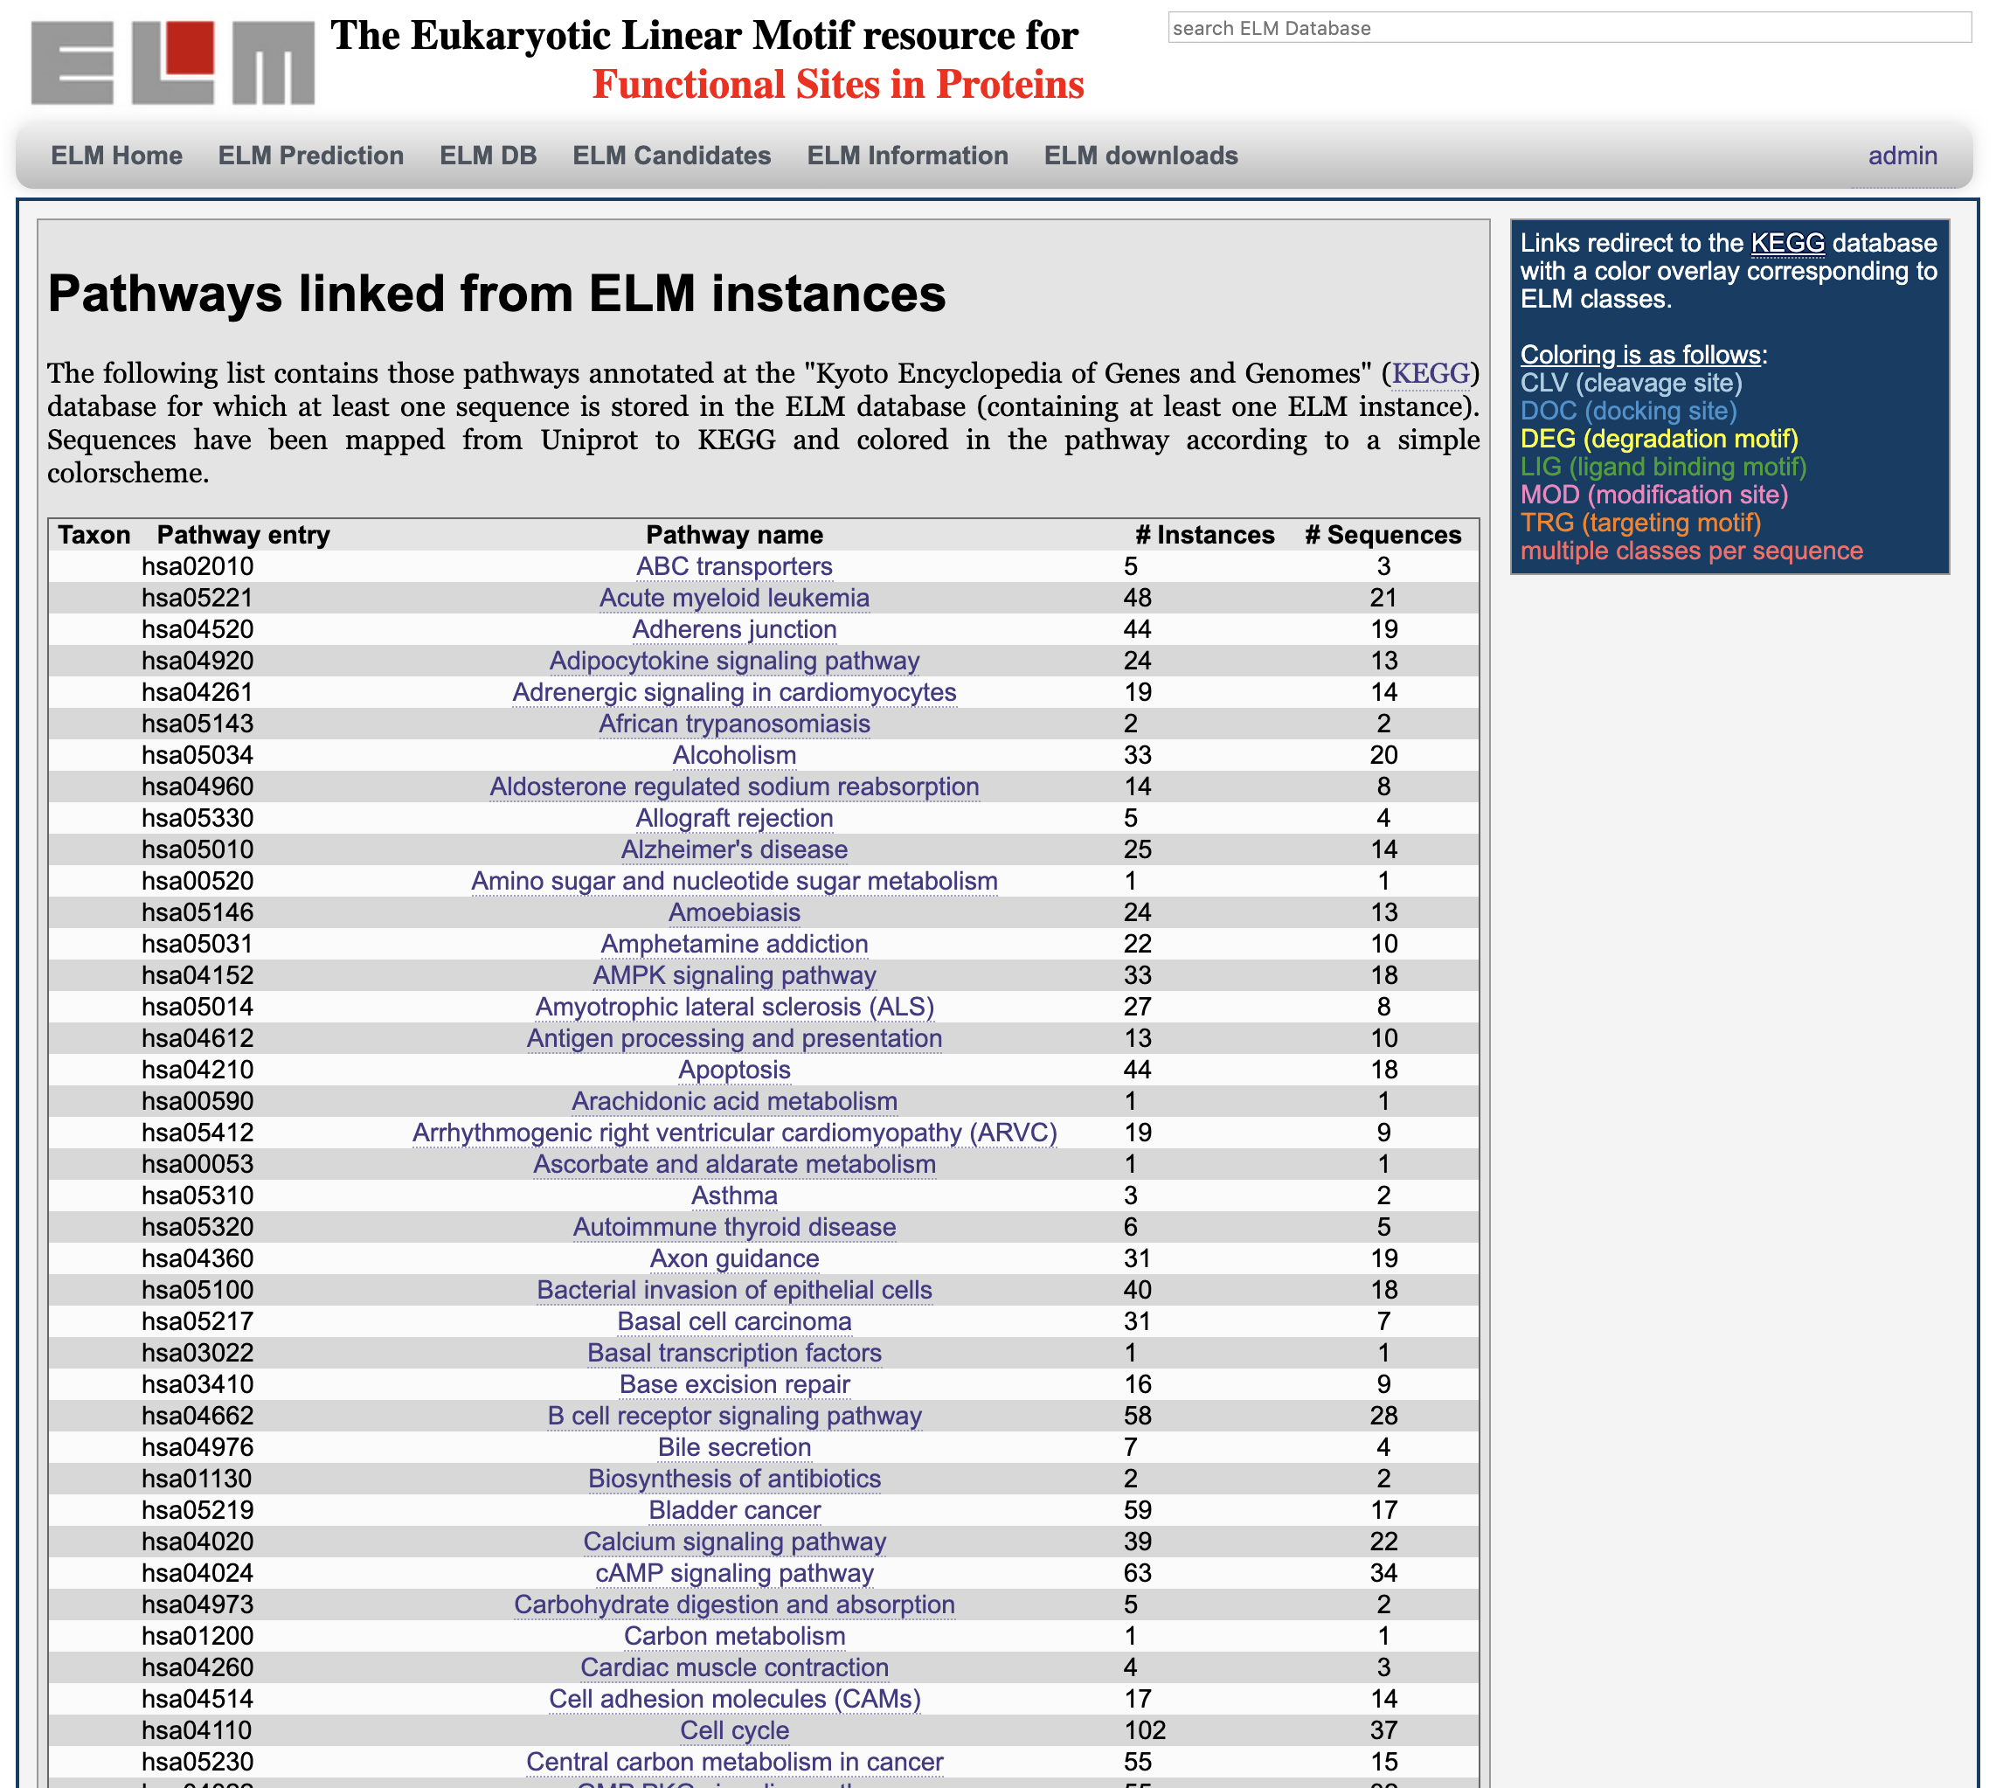
Linear Motifs in Cell Cycle: http://elm.eu.org

Slide 4
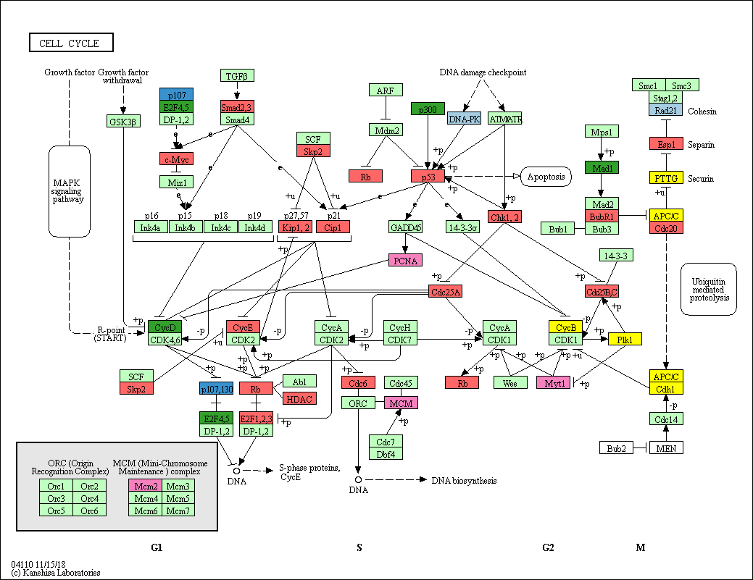
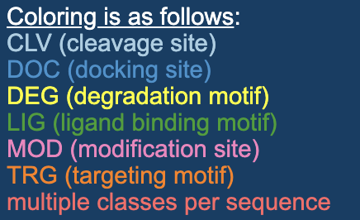
Linear Motifs in Cell Cycle

Slide 5
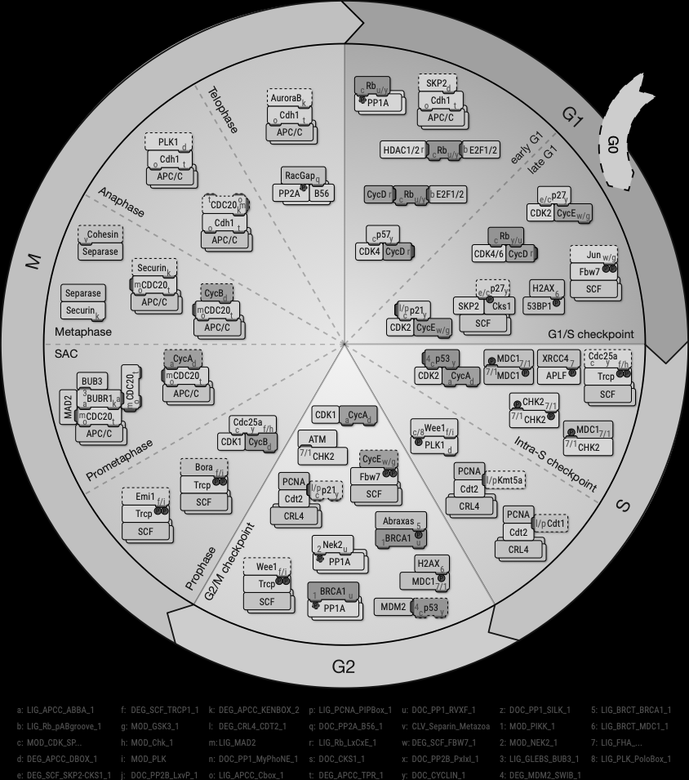
Linear Motifs in Cell Cycle
Chemes, L.B., et al., in preparation

Slide 6
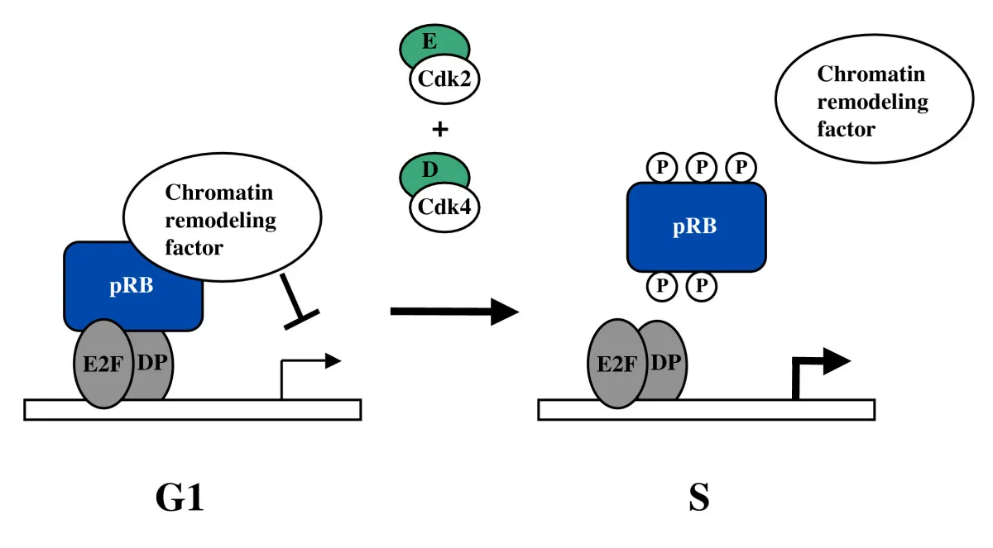
Retinoblastoma (pRb): A Cell Cycle Regulator
Dick, F.A., 2007
Notes:
pRb: Arrests cell cycle in G1 during development and after stimulation (like DNA damage).
pRb binds E2F, inhibiting its TF activity. E2F transcribes Cell cycle-related genes.
pRb bound to E2F recruits chromatin remodeling proteins (like histone deacetylases like HDAC) to further repress transcription.
cyclin/CDKs phosphorylate pRB
The retinoblastoma protein is most frequently inactivated in cancer.

Slide 7
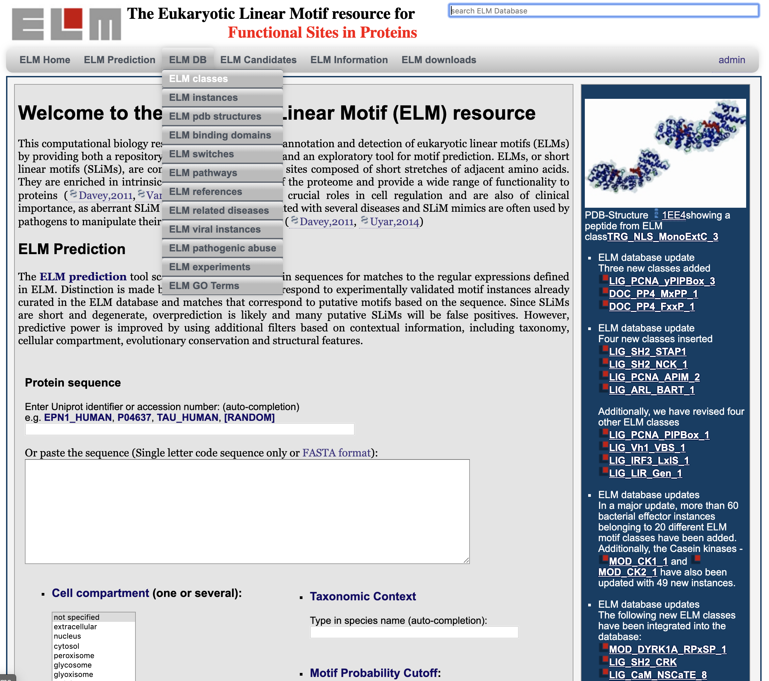
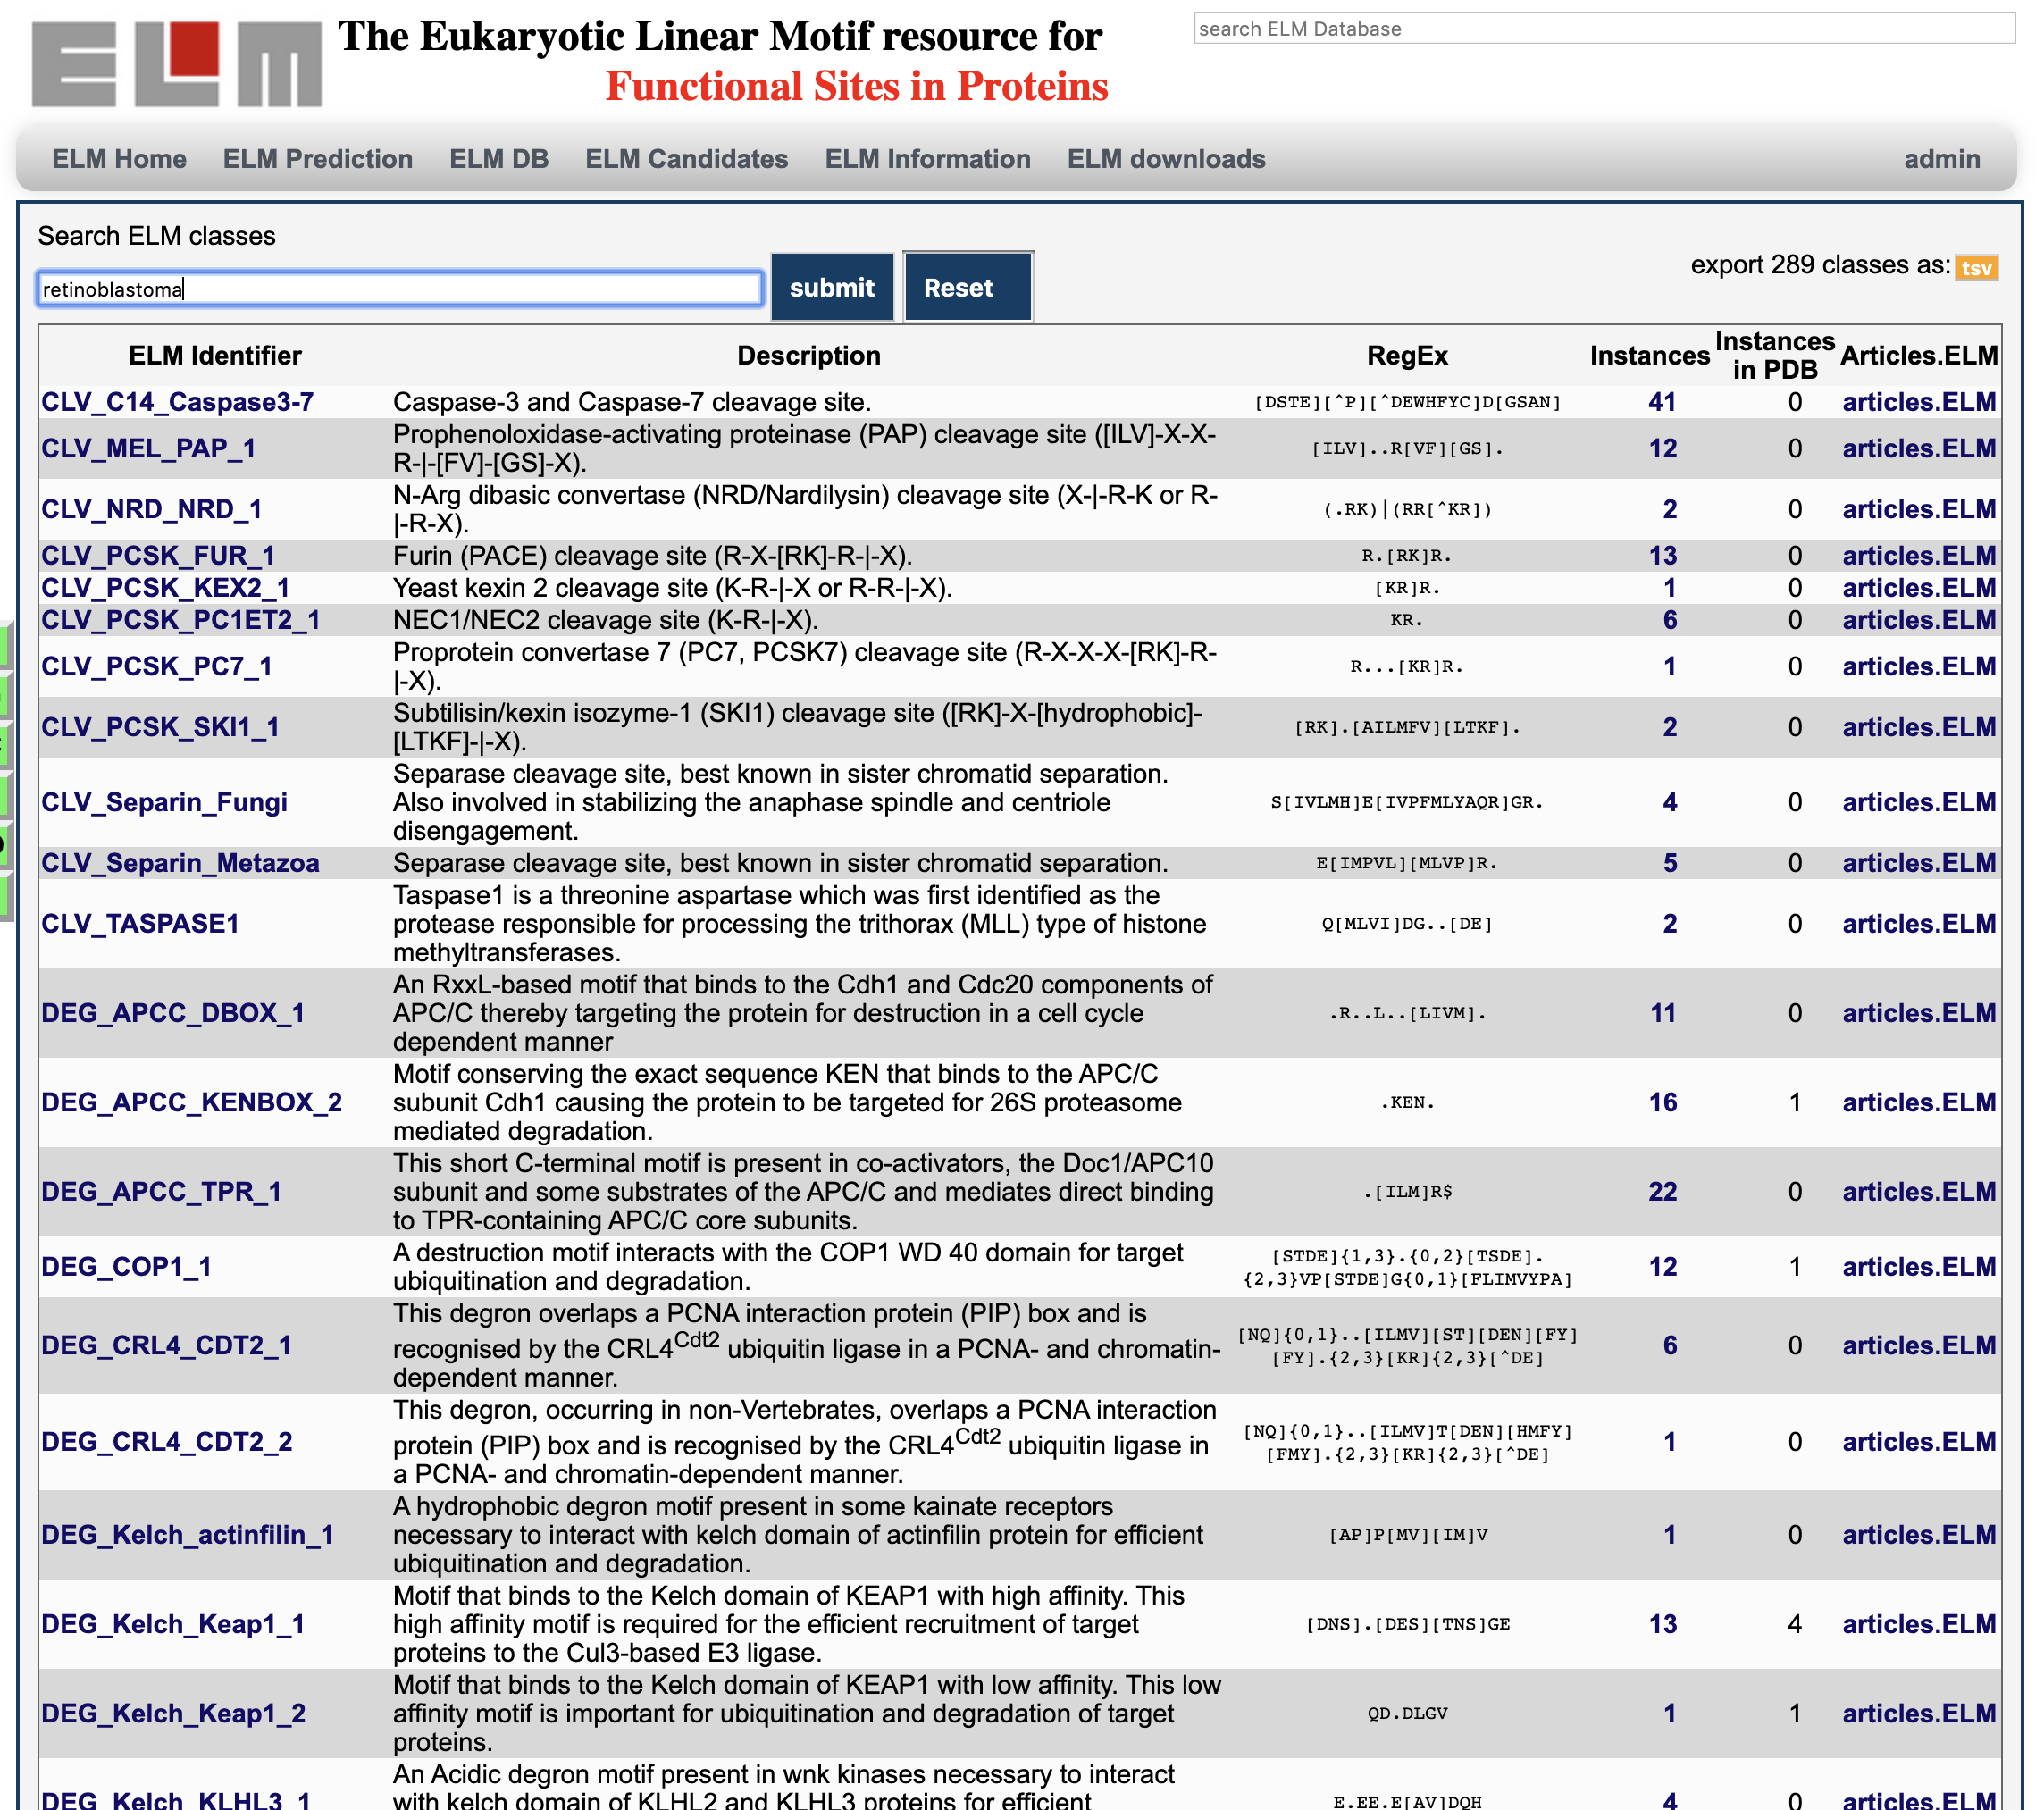
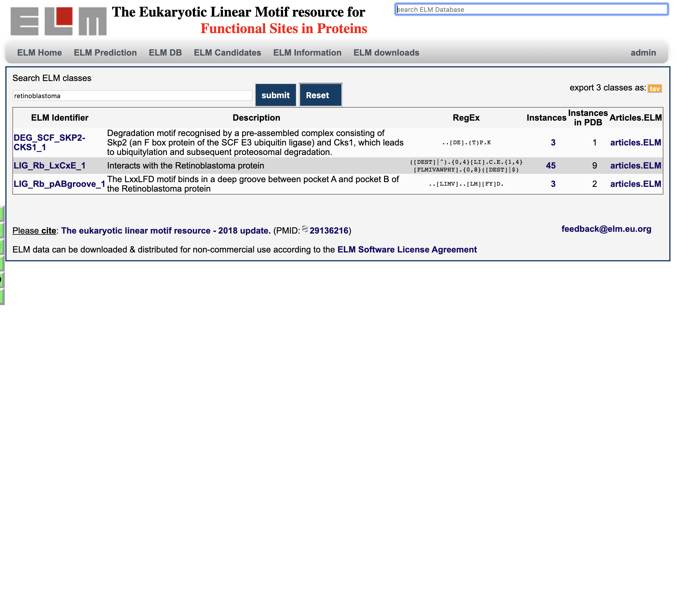
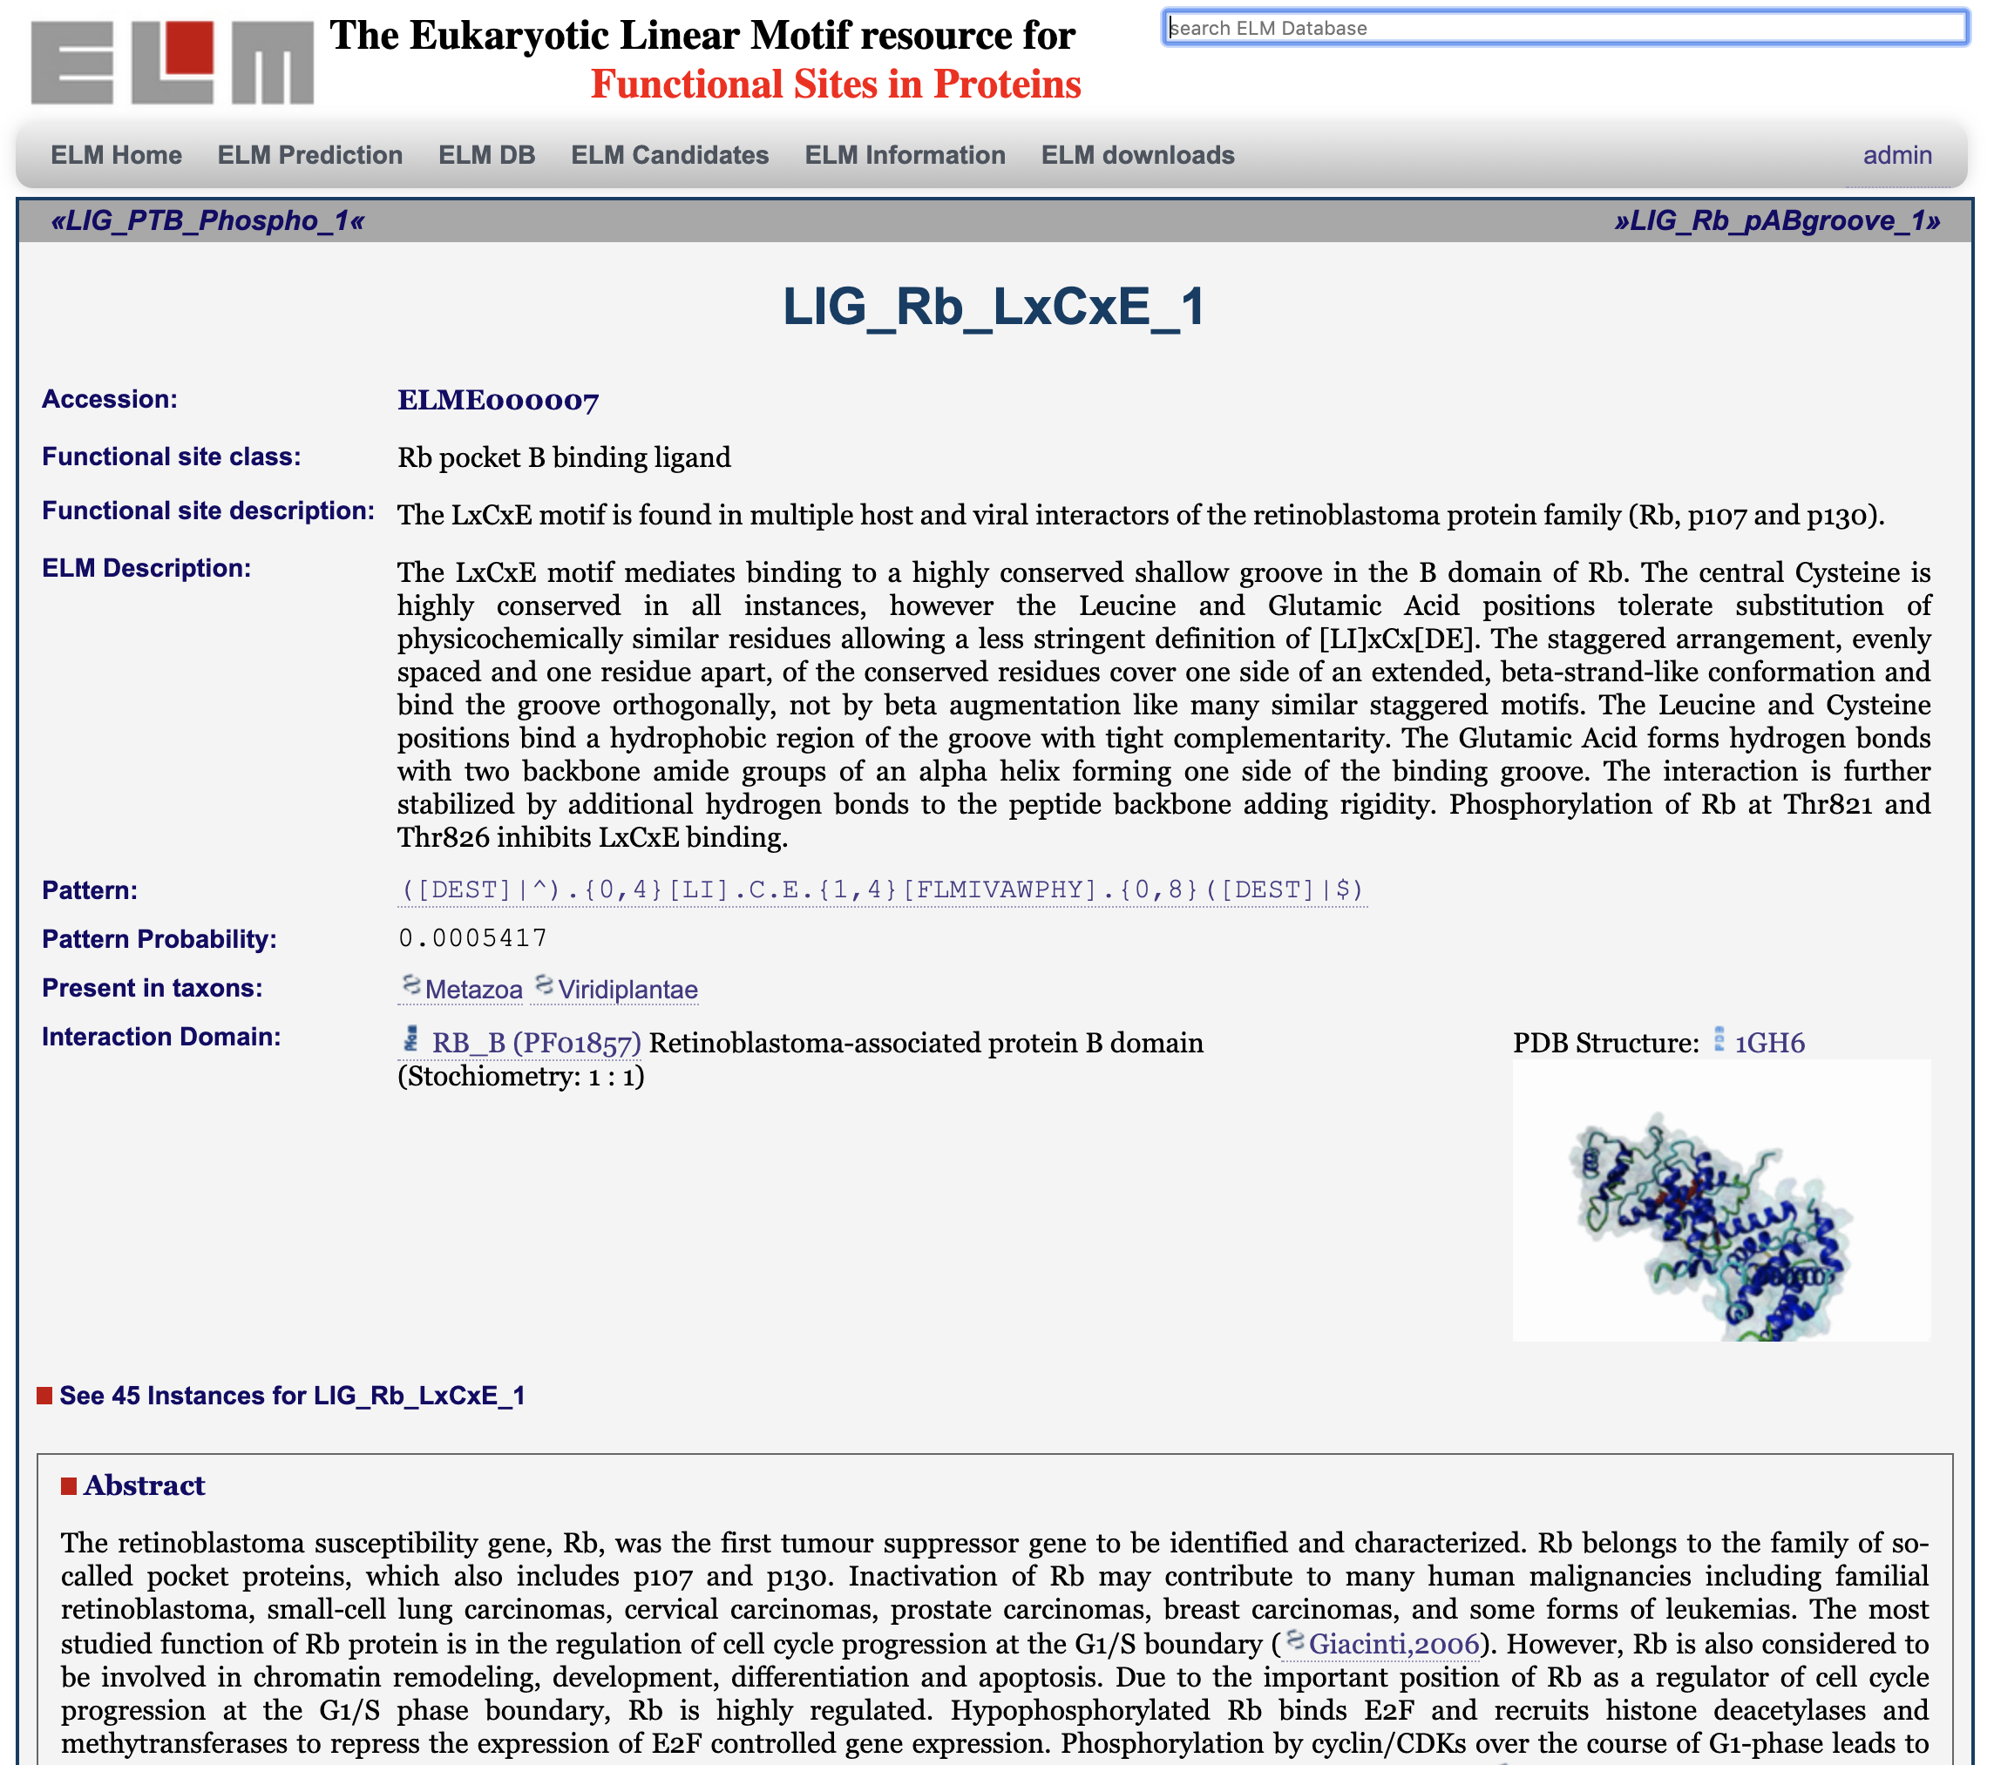
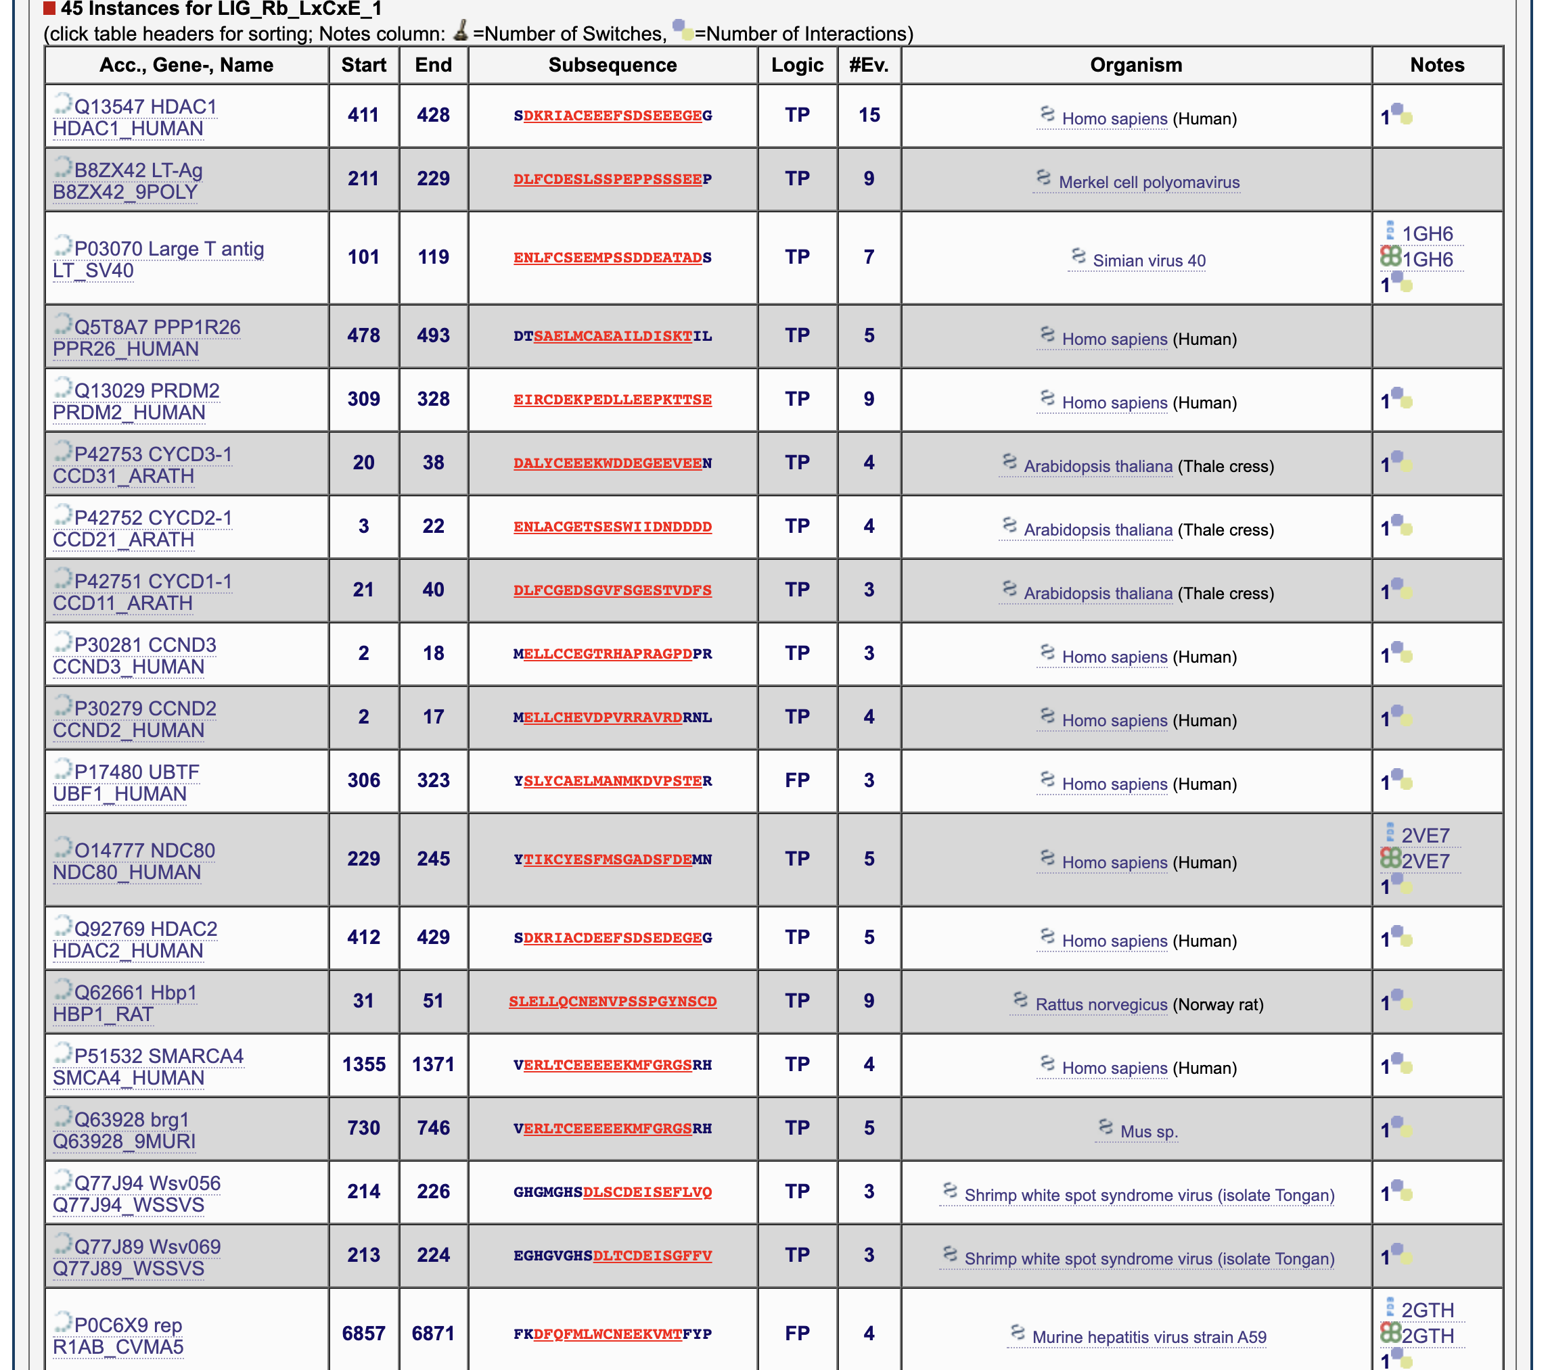
LxCxE (pRb) motif: http://elm.eu.org

Slide 8
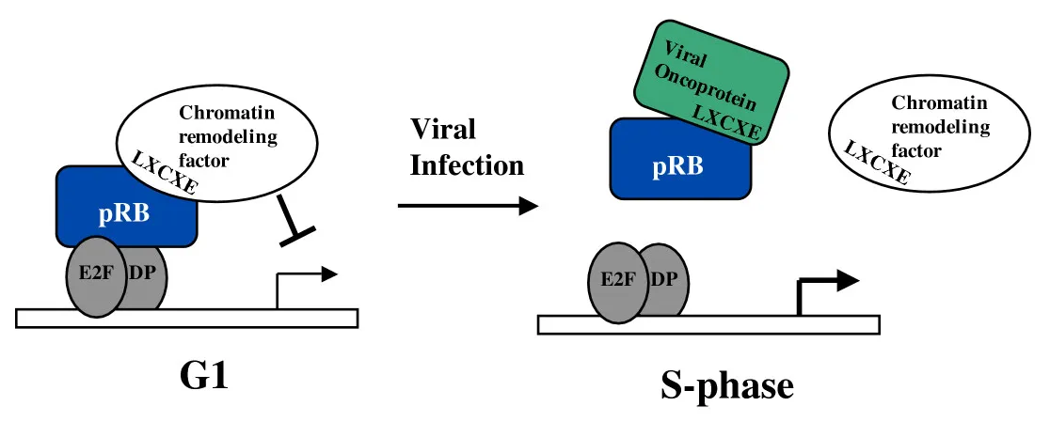
Viral Hijack of Retinoblastoma (pRb)

Slide 9
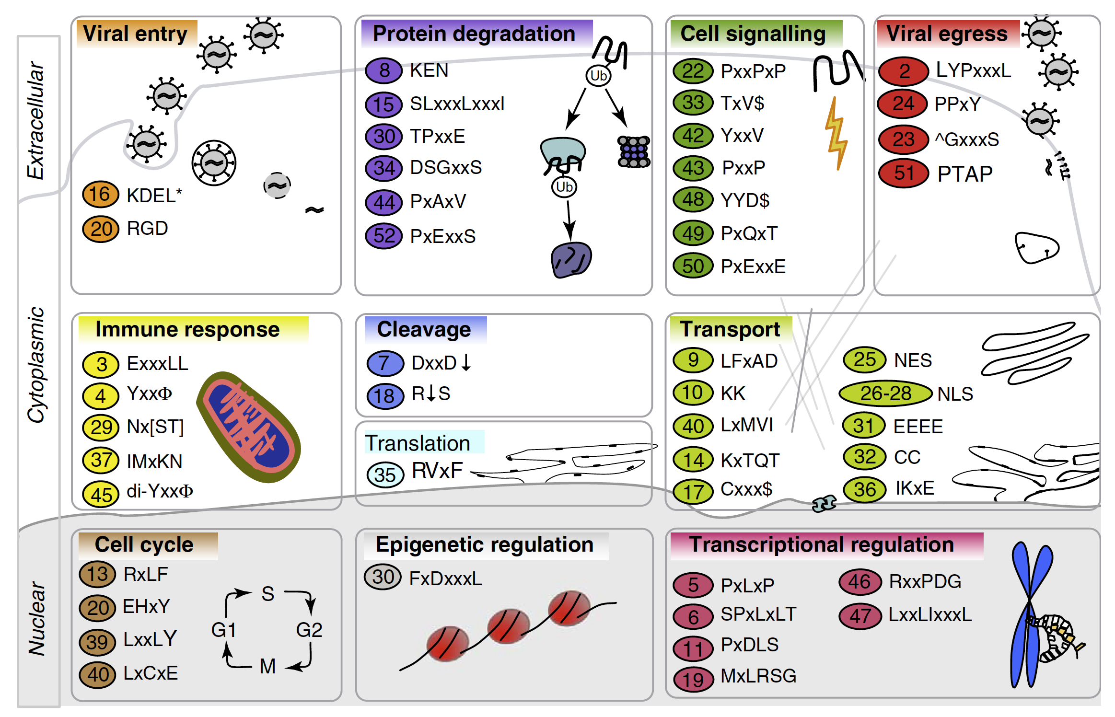
How Viruses Hijack Cell Regulation
Davey, N.E., et al., 2011

Slide 10
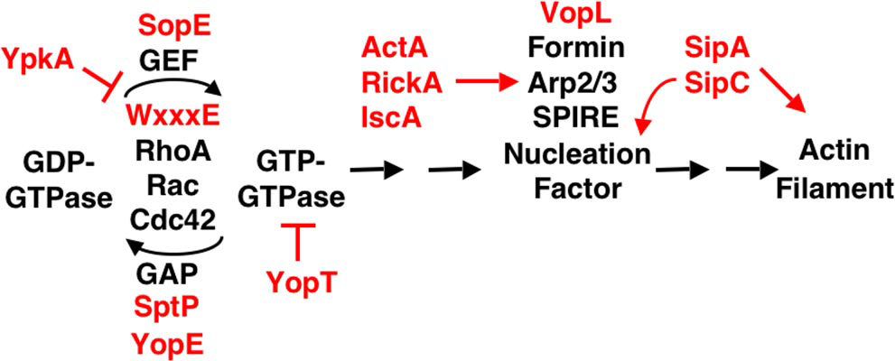
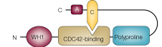
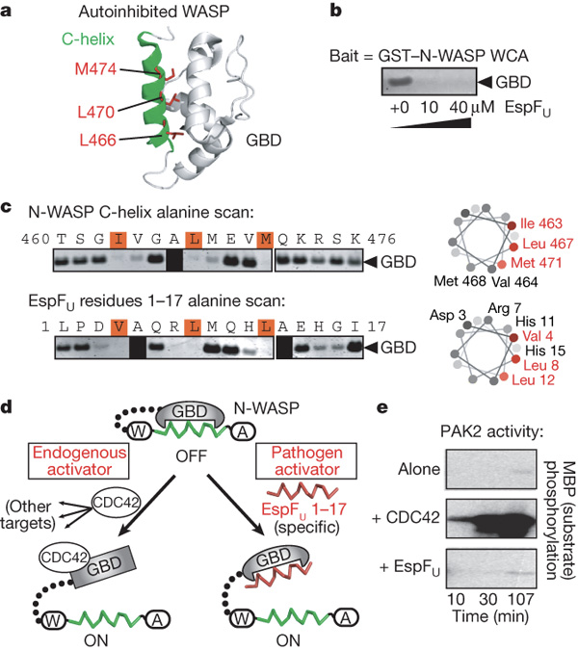
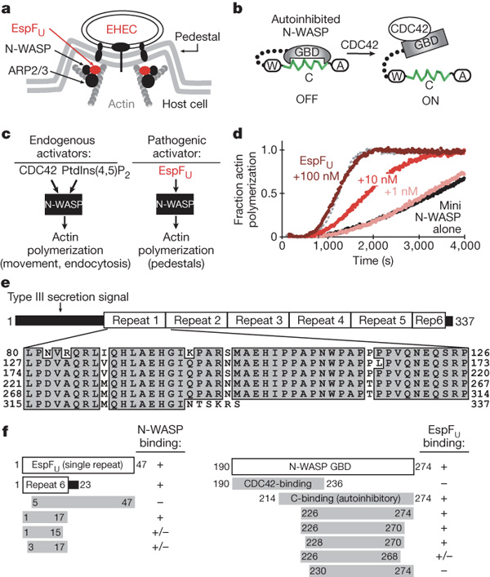
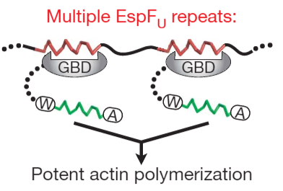
Pathogenic Bacteria Exploit Host Actin Polymerization
Tir
EPEC
EPEC
EspF
VopF
EspFU
Tir
EspF(U)
EspI
SH2
PDZ
IpaA
L. monocytogenes
GBD C-helix
sca4
ActA
WASP
EVH1
Inactive
host
N-WASP
Actin polymerization
GBD
WH2
VopF
Host cell
EHEC EspF(U)
Vibrio cholerae
Pathway
Host protein
Complex
Type 3 Secretion System
Based on Liverman, A. D., et al., 2007
and Based on Sallee N.A., et al., 2008

Slide 11
Practical 3
Go to http://www.uniprot.org
Search for Tir protein from Escherichia coli
Use: name:tir organism:"escherichia coli”
Remove identical sequences
Use: UniRef 100%
Download all sequences
Open the sequences in JalView
Remove sequences too short or too long (Tir is ~540 aas)
Sort them by length
Remove sequences with < 535 aas
Align them (use ClustalO)

Slide 12
Practical 3
Manually improve the alignment
Remove potential low quality sequences
Remove column gaps
Remove misaligned sequences
Sort the sequences by sequence similarity
Use the Sort By Pairwise Identity tool
Refine the sorting manually (Select + arrows)
Identify conserved and partially conserved Tyrosine residues
Ctr+F Y

Slide 13
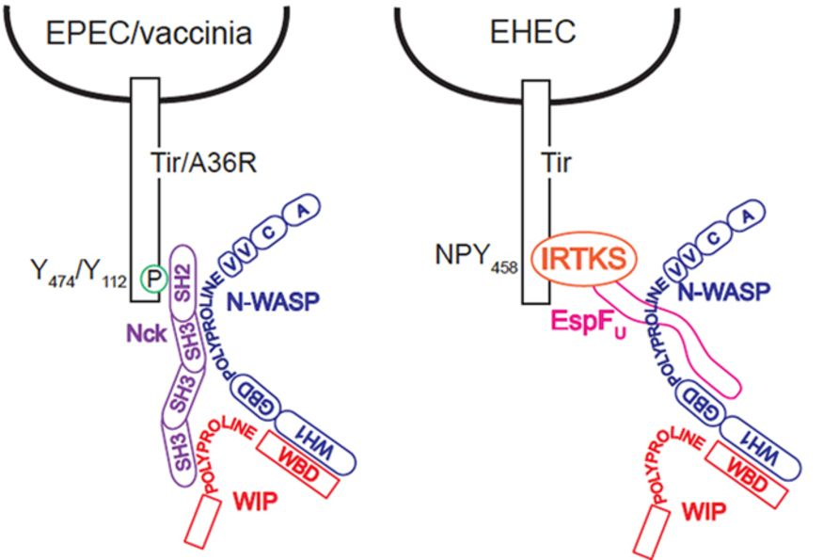
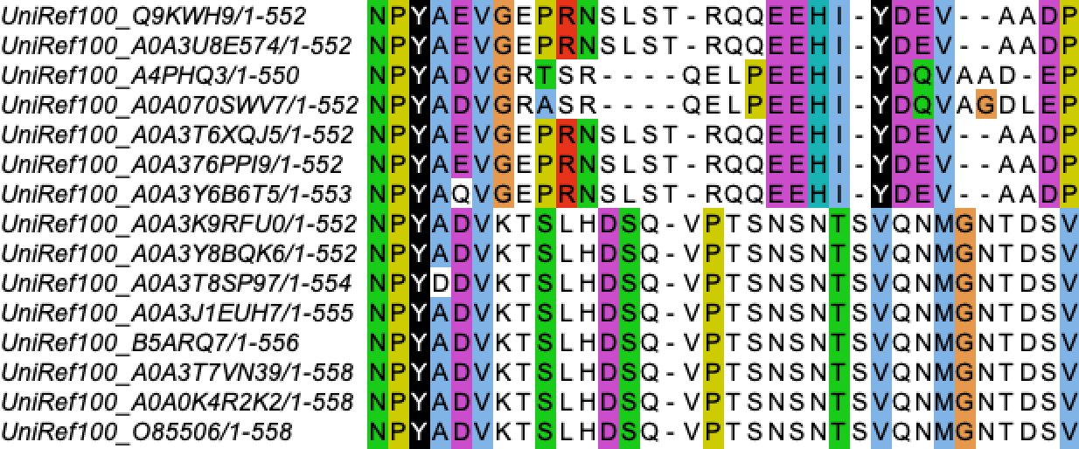
Practical 3
Modified from Garber J.J.,
et al., 2012
EPEC
strains
EHEC
strains

